Slide 1
Identifying Attack Goals
Assets, Entry Points and Data Flow Analysis

Slide 2

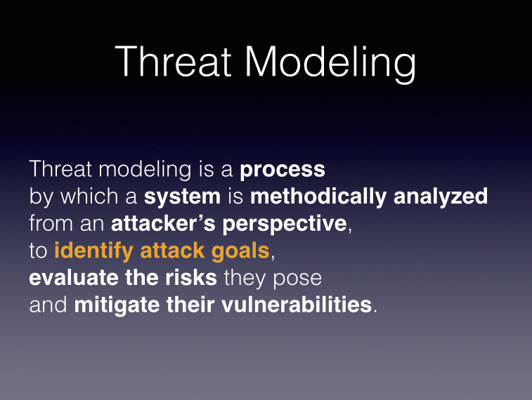
Notes:
So, we remember this slide… we’re first going to identify attack goals.

Slide 3

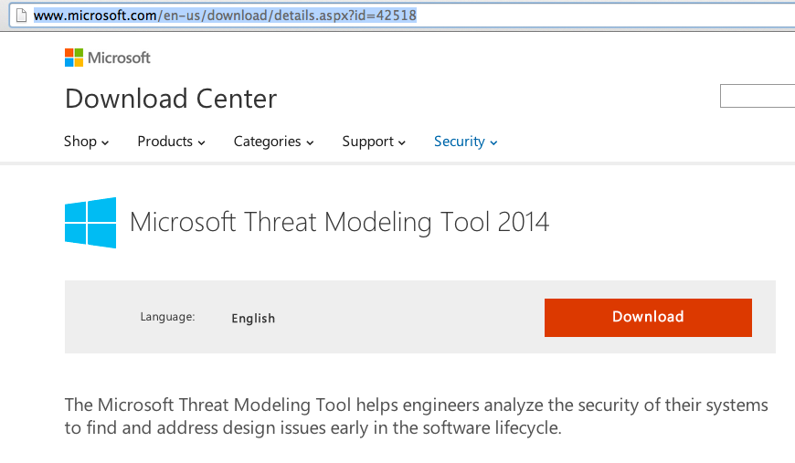
DATA FLOW Tool Visio for Threat Models
Notes:
http://www.microsoft.com/en-us/download/details.aspx?id=42518
We don’t want to load ourselves up with a lot of formalism, but a little is useful, and so we’re going to be creating diagrams. Microsoft makes a tool custom-built for creating these diagrams.

Slide 4

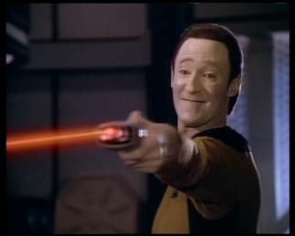
threats come from data
Notes:
So where do threats come from? What makes our system vulnerable?
[CLICK] Threats come from data. Which makes sense, right? Data is another way of saying state, and if the attacker cannot modify our state, then there’s nothing the attacker can do to affect us. So the first step in figuring out how we might be vulnerable is identifying our data, identifying where our data comes from, and identifying how we consume that data.
[CLICK] Well, some threats come from Lore. But mostly they come from Data.

Slide 5
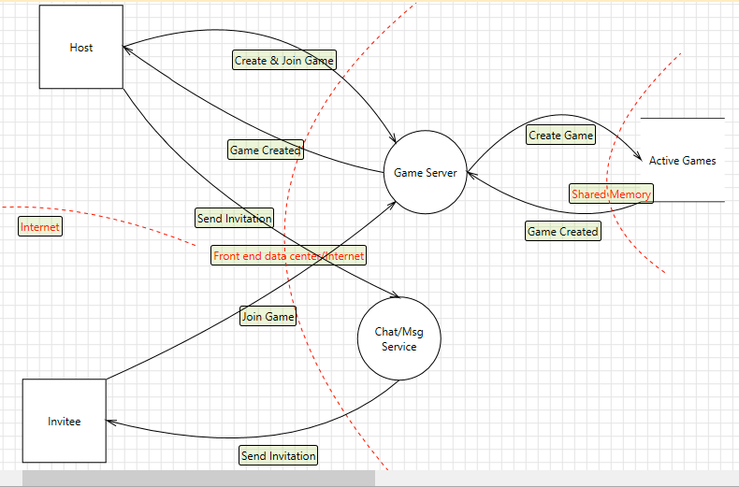
Data Flow Diagrams
Notes:
The tool we use to document and analyze our data is a data flow diagram. A DFD is just like a flowchart, except where a flowchart documents the flow of command through your code, a DFD documents the flow of data through your system.
THIS IS AN EASY THING TO SCREW UP, so let me make this crystal clear. What you see in this diagram are FLOWS OF DATA—where data comes from, where it goes to. Don’t try to impose SEQUENCE on this, because that’s not what it’s for. It generally doesn’t matter what happens when; all we care about is where data comes from and where it goes to.

Slide 6
Elements
Processes: Code (not an OS process)
External Interactors: A source or sink of data that’s outside your control (e.g., the client)
Data Stores: Something that holds data—memory, a file, a database
Data Flow: The transfer of data from one element to another
Trust Boundary: Border between two elements that do not trust each other
Notes:
A DFD has five things in it. The Threat Modeling Tool has special drawing commands to create each one. [CLICKING]
Processes: Code (not an OS process)
External Interactors: A source or sink of data that’s outside your control (e.g., the client)
Data Stores: Something that holds data—memory, a file, a database
Data Flow: The transfer of data from one element to another
Trust Boundary: Border between two elements that do not trust each other

Slide 7
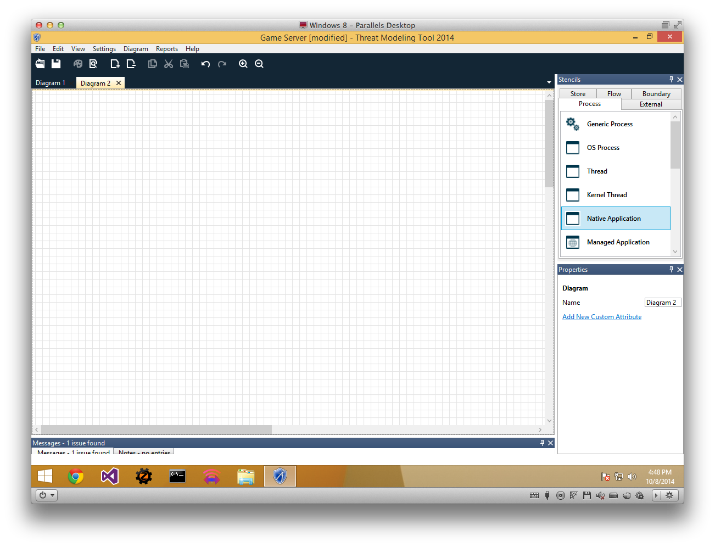
Notes:
When we first launch the threat modeling tool, we get a blank sheet like this. The first step of any threat model is the data flow diagrams, so that’s where the tool begins.
We’re going to create a DFD for a very simple case: a server-authoritative two-player game, where one player’s going to create a game (and be the “host”), and then send an invitation to the second player.

Slide 8
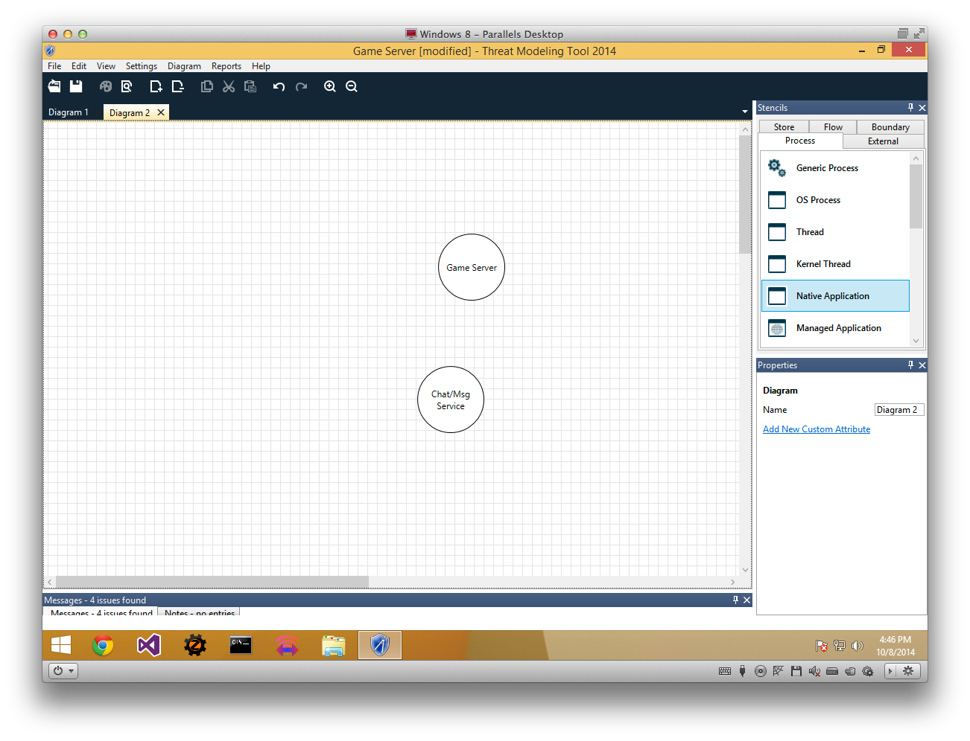
Notes:
We start with two processes—the game server, which runs the game logic and is responsible for who can and can’t get into the game, and a chat server, which is responsible for passing out-of-game messages back and forth between clients.
Processes in a DFD are identified as circles.

Slide 9

Notes:
We have two external actors—the host who’s creating the game, and the invitee the host is inviting to join the game.
External actors are squares.

Slide 10

Notes:
We only have one data store, and that’s our list of active games. That store could be anything—it could be a flat file on a disk, it could be stored in Redis, it could be stored in SQL Server. What’s definitely true though is that if we have a significant number of users, we’ll have multiple game servers, and so the list of active games has to be separate from any individual one of those servers. Thus, it’s a separate data store, not just part of a process. Internal state entirely inside one process doesn’t have to be documented as a separate data store, because there’s no vulnerable data flow to interact with.
A data store is a box with no sides—just a line above and a line below.

Slide 11
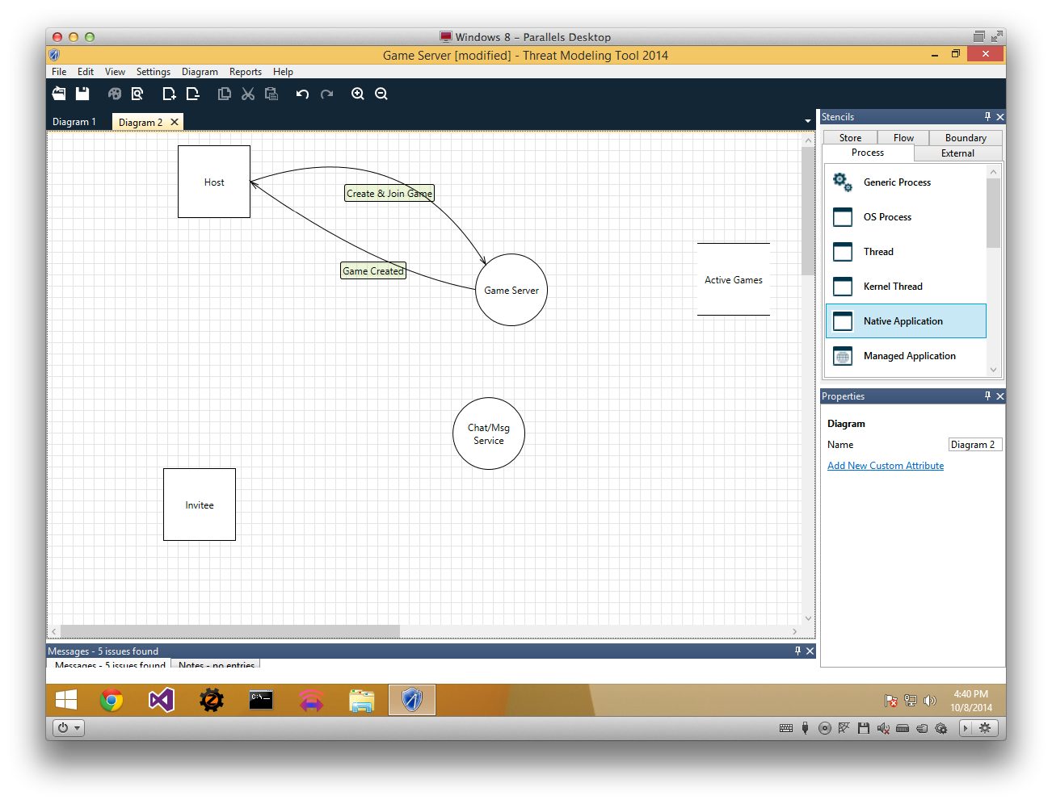
Notes:
Now we create our data flows. The host tells the game server “make this game, and put me in it”. The game server tells the host “sure, here’s the game”.
Data flows are represented by arrows.

Slide 12
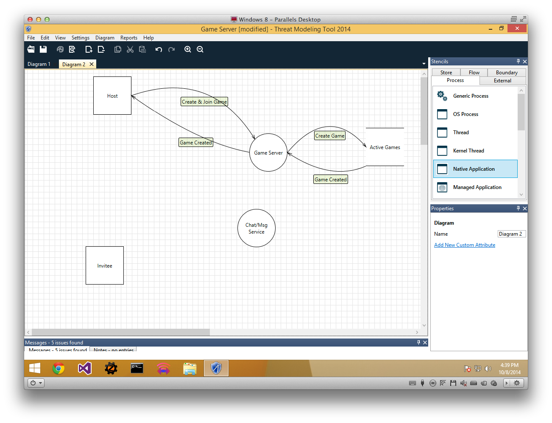
Notes:
The Game Server creates the game in the store of Active Games, and the Active Game store reports that information back to the Game Server. Note that, time-wise, this happens in between the host’s “create game” request and the game servers “here’s your game” response. DFDs don’t encapsulate sequence, just flow!

Slide 13
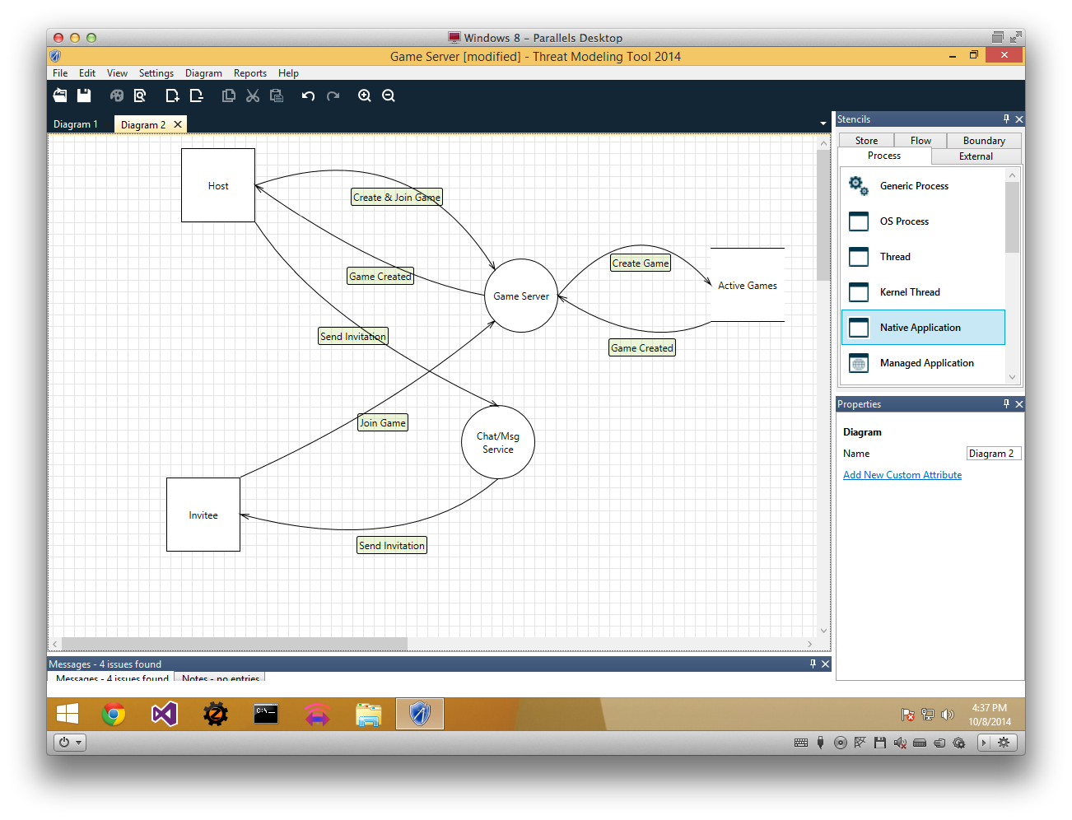
Notes:
Last, we create data flows from the host to the message server—“pass this to the invitee”—from the message server to the invitee—“here’s your invitation”—and from the invitee to the game server—“I’d like to join”.

Slide 14
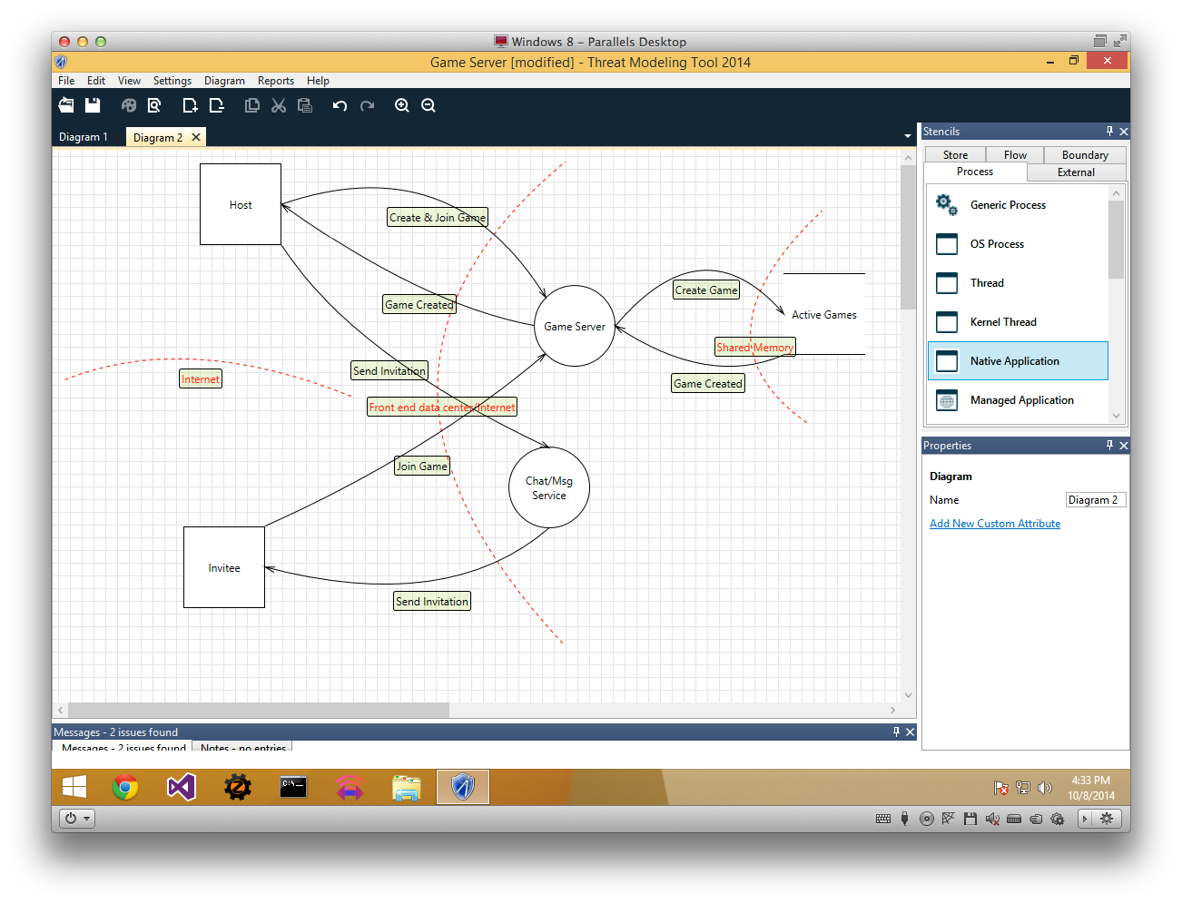
Notes:
Finally let’s create trust boundaries. Trust boundaries are dashed lines.
Obviously our clients are outside our data center, so we create a trust boundary right here in the middle. We also have a boundary between our active games datastore and our process—if the datastore is a database, then someone else could be modifying it; if it’s a shared cache among multiple machines, maybe one of the other machines is compromised. Finally we have a trust boundary between the two clients, since they don’t trust each other… but since we don’t have direct data flow between them, the tool complains that this boundary is pointless. We tell it to ignore that warning.

Slide 15
Notes:
The next deck is going to talk about how we come up with threats based on this, but let’s focus first on what this document by itself teaches us about our system. [INTERACT]
Start to think about our protocol
Start to think about our architecture
Maybe didn’t even realize we need a message service
All kinds of security issues start to come to mind

Slide 16
Easy Mistakes
It’s not a flowchart!
All data flows must begin or end at a process.
A process that has input flows but no output flows is a black hole.
A process that has output but no input is a miracle.
Make sure each process has all the data needed to create any output flows.
Notes:
[CLICKING]
It’s not a flowchart!
All data flows must begin or end at a process. Even going from one store to another has to go through a process—otherwise, they’re just one store.
A process that has input flows but no output flows is a black hole. Maybe that’s okay, because its use is out of scope—an analytics server, for example.
A process that has output but no input is a miracle. Where’d the data come from?!
Make sure each process has all the data needed to create any output flows.

Slide 17
Threats come from data, so we document what our data is, where it comes from, where it goes to and what we do with it.
A DFD has five kinds of elements: processes, external interactors, data stores, data flows and trust boundaries.

Slide 18
LIVE DEMO
Notes:
Remember that Game Center leaderboard thing? Let’s threat model that, because it’ll be super-easy.

Slide 19
Evaluating Risks
Attack Trees

Slide 20
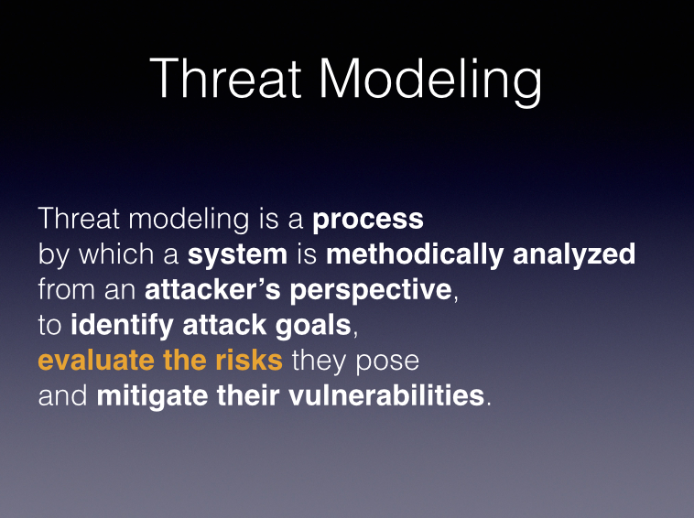
Notes:
Now we’re going to figure out how we’re in danger.

Slide 21
THREATS = STRIDE x DFD ELEMENTS
“STRIDE per Element”
Notes:
Remember that the purpose of threat modeling is to be methodical, to force us to think of things that didn’t occur to us at first glance. It’s okay for us to be too thorough, to think of threats that can’t actually happen in practice—we’ll figure that out after we write everything down. But we want to get all our assumptions down on paper.

Slide 22
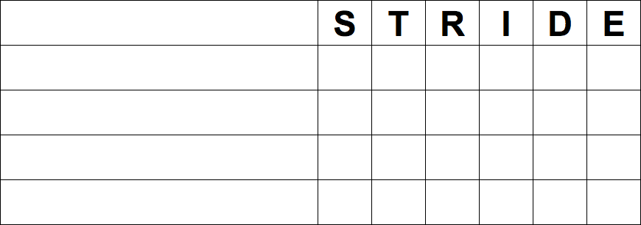
STRIDE x ELEMENTS
Notes:
Not every STRIDE type applies to every element. Nothing applies to trust boundaries—that’s why this grid only has four rows.

Slide 23
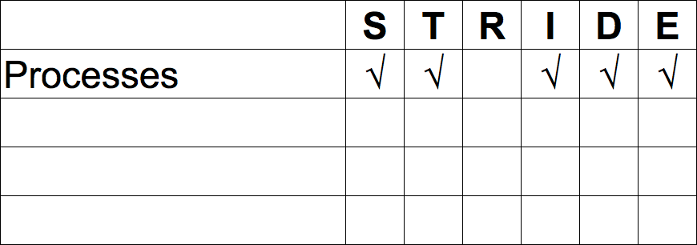
STRIDE x ELEMENTS
Notes:
Everything but repudiation applies to processes:
An attacker could pretend to be a process (that’s what happens in DNS poisoning).
They could tamper with the process.
They could disclose information.
They could be brought down through denial of service.
Or an attacker could gain elevated privileges against them.

Slide 24
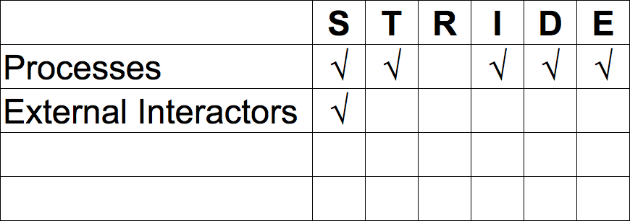
STRIDE x ELEMENTS
Notes:
An external interactor can really just be attacked one ways: they can be spoofed. If we’re worried about other threats—for example, if we’re worried that someone could bring down a user’s game client with a DoS attack—then what we’ve really got is an untrusted process on that far machine, and the external interactor is the user of the machine.
Similarly, while information about an external interactor could be disclosed, the way to account for that is in disclosure of what we know about that interactor, which is to say, disclosure of data we’ve received from them.

Slide 25
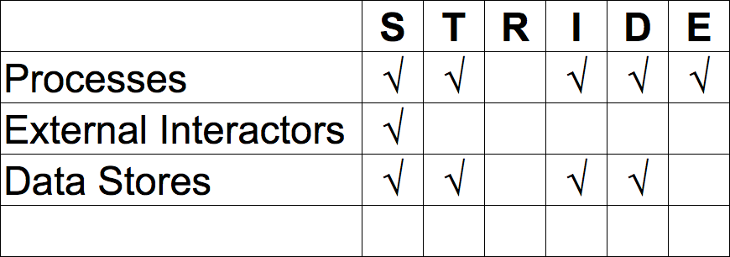
STRIDE x ELEMENTS
Notes:
A data store could be spoofed, tampered with, it could have its information disclosed, or it could be brought down with denial of service. If we’re worried about someone elevating privilege against it—if it’s a SQL Server, and we’re worried someone will gain admin rights—then what we’re really worried about is the server admin process. In a DFD, data stores never modify themselves, so there can be no privilege to elevate.

Slide 26
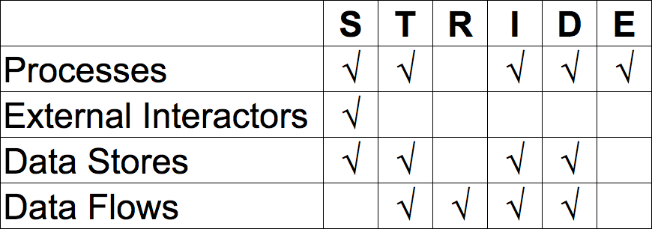
STRIDE x ELEMENTS
Notes:
Data flows are subject to the same threats as data stores, because they’re really two aspects of the same thing, right?
In addition, data flows are the only thing that can be repudiated. Repudiation means repudiating an action, and actions in a DFD are data flows.

Slide 27
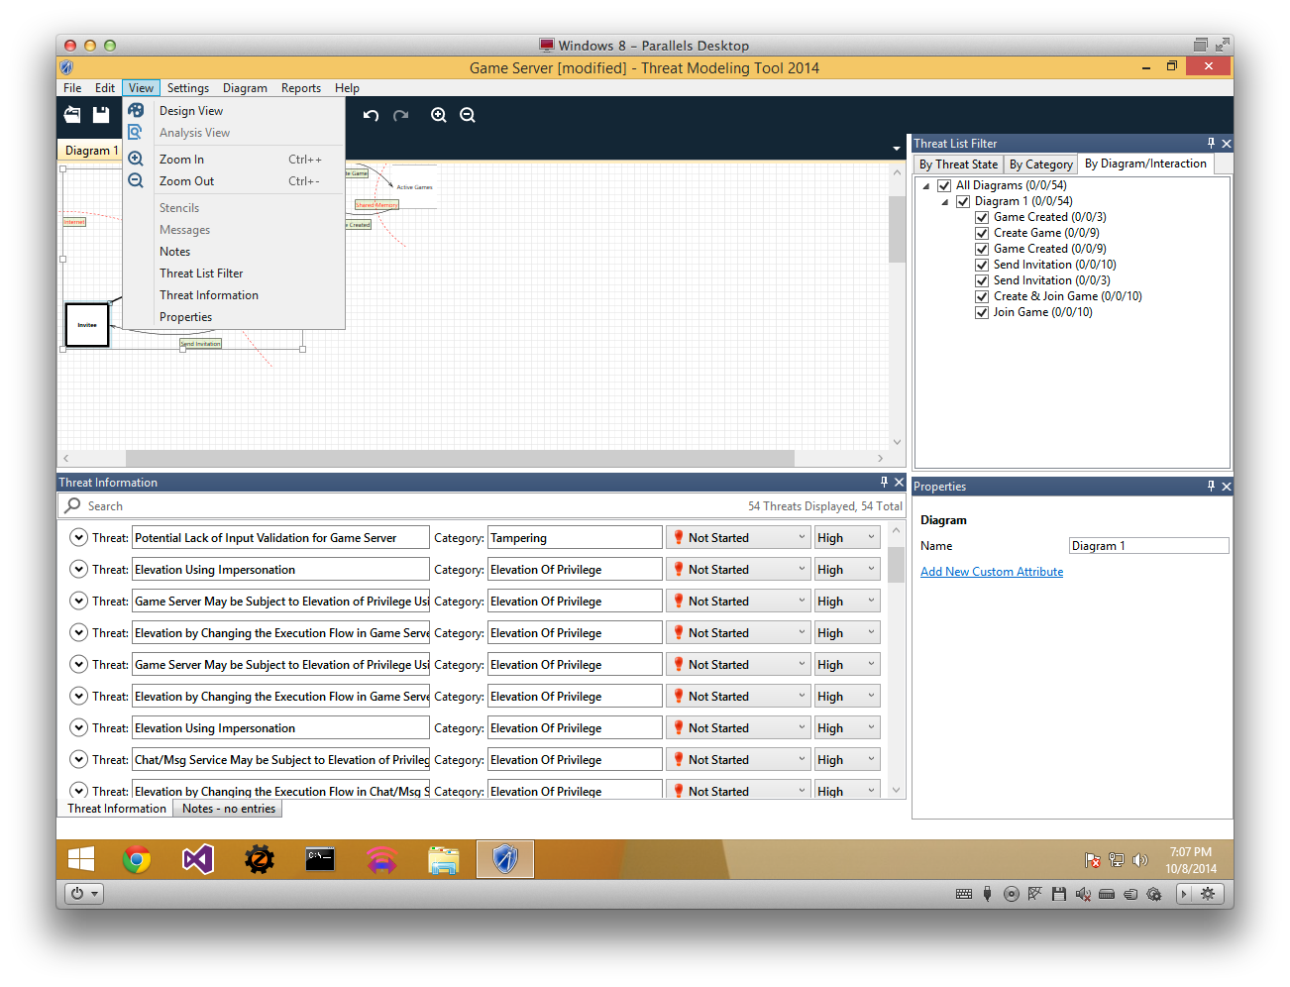
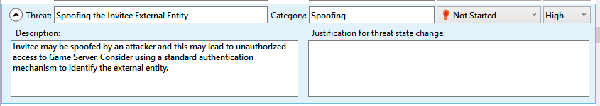
Notes:
Now here’s where the TMT gets really cool: When we switch from Design View to Analysis View, we get a list of all the STRIDE x Elements created for us! It’s a little more specific than the simple “STRIDE x Elements” approach—for example, it treats an external entity receiving data as a separate set of spoofing versus the same entity sending data—but it’s the same basic idea. It also may miss some threats; it’s there to help you get started, not to replace your own diligence.
[CLICK] For each entry, we can unfold it to see that the tool has automatically created one possible description of how this attack could happen. We’d want to replace that with our own description based on our superior knowledge of the system.

Slide 28
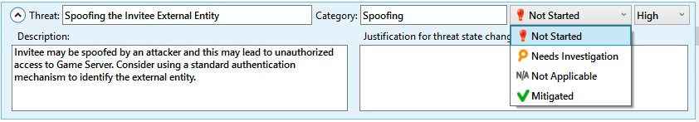
Prioritize and
Narrow Scope
Not Started: Haven’t looked at it at all yet.
Needs Investigation: Attack trees in progress.
Not Applicable: Not a concern.
Mitigated: Attack tree complete and mitigated.
Notes:
Now we’re going to look at each of our threats and set its state. They all begin in Not Started, which is essentially an error—we should get the threats out of this state soon.
Needs Investigation says we’re creating, or going to create, an attack tree for the threat. We’ll talk about attack trees next.
Not Applicable means that the threat is either truly impossible or outside our scope. We don’t want to resort to hand-waving “that can’t happen” very often, because the entire point of the threat model is to be clear and explicit about threats. But it’s okay to rule stuff out of scope. For example, in this threat model, one of the things the tool automatically flags is that an attacker might sniff the data flow from the Game Server to the Active Games database. Well, that flow happens entirely inside our data center, so if an attacker can sniff that, we have much, much bigger concerns. So it'd be totally appropriate to mark that as Not Applicable.
Finally, if we’ve created an attack tree for a threat and all paths through it are mitigated, then we can mark the threat as Mitigated and relax about it.
We can also assign priorities to the Needs Investigation threats. At this stage, we haven’t documented how likely a threat is, so any prioritization we do now is based entirely on how destructive the threat would be. Anything touching user passwords, personally identifying information, credit cards or real-money purchasable items, we definitely want all that stuff marked HIGH. But the risk that an attacker would sniff the game-creation request, that’s probably LOW. This prioritization will inform what order we make our attack trees in.

Slide 29

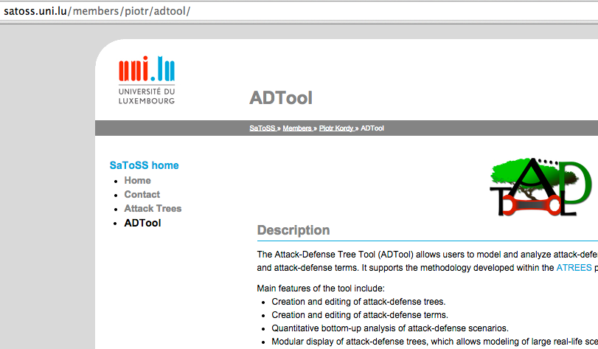
ATTACK TREE TOOL
Notes:
*** I’m going to talk about what attack trees are in a minute; ignore that for now. I just want to introduce the tool we’re going to use before I show screenshots of it.
http://satoss.uni.lu/members/piotr/adtool/
So, this part is actually kind of annoying. Previous versions of the Microsoft threat modeling tool included tools to draw attack trees. The new 2014 version doesn’t. The new version has other new stuff, like the automatic STRIDE x Elements generation, that you don’t want to throw away, and creating attack trees is actually pretty easy to do in any program (Visio, PowerPoint, even plain text), so it’s not worth abandoning the MS tool. But it’s annoying.
This tool is okay, but not wonderful. It’s a research project from the University of Luxembourg. Cross-platform, which is nice; Java, which is blergh. But it’ll get the job done.

Slide 30
ATTACK TREES
Answers the question “What has to be true for an attacker to successfully perform this attack?”
Conceptually an if statement: bool success = X || (Y && (Z || W));
Shown in tree form to make it easier to follow.
Notes:
[CLICKING]
Answers the question “What has to be true for an attacker to successfully perform this attack?”
Conceptually an if statement: bool success = X || (Y && (Z || W));
Shown in tree form to make it easier to follow.

Slide 31
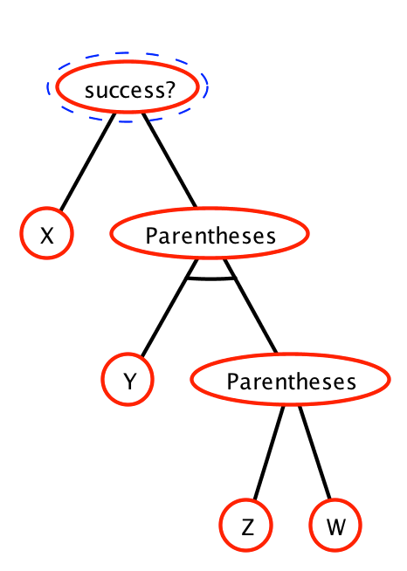
Format X || (Y && (Z || W))
Root node is the attack itself
Siblings connected with an arc must all be true (AND)
Siblings with no arc just need one to be true (OR)

Slide 32
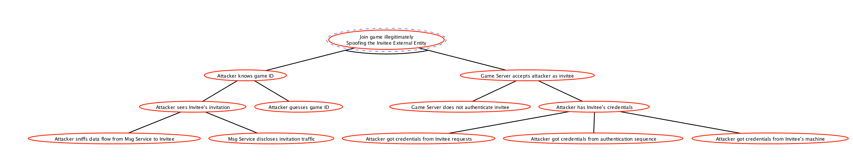
Notes:
The charts this tool makes are really sprawled out; sorry I can’t do anything about that. The actual source files for these will be up on Moodle tomorrow.
So let’s take our “Spoofing the Invitee External Entity” threat. What’s happening there is that the attacker is joining a game that he’s not invited to, so that’s the root of our tree.
On the left side, we have “Attacker knows game ID”—the attacker can’t join a game if he doesn’t know its ID value.

Slide 33
Notes:
On the right side, we have “Game Server accepts attacker as invitee”—the host specified the exact player invited to the game, so if that’s not the player who shows up, the game server will reject them.
This is an AND condition—both must be true for this attack to work. If the attacker doesn’t know the game ID, they don’t know how to get in; if the attacker can’t impersonate the invitee, they can’t get in even if they know the game ID.

Slide 34
Notes:
Back on the left side, the attacker will know the game ID if the attacker can see the invitee’s invitation. That’s only possible if the attacker sees the data flow from the Msg Service, OR if the Msg Service has an information leak. Now, those sound like threats in their own right—the left one is “Information Disclosure of Send Invitation data flow” and the right one is “Information Disclosure from Msg Service”.
The attacker will also know the game ID if it’s guessable. For example, if the first game ID is 1, and it just increments by 1 thereafter, then if the attacker legitimately plays a game and gets game ID 98, say, then they can be reasonably confident that game ID 99 will be valid.

Slide 35
Notes:
Over on the right side, we have more OR conditions. The game server lets the attacker in if the game server isn’t authenticated—you’d be shocked at how often that happens. OR the game server lets the attacker in if the attacker has valid credentials.
The attacker has valid credentials if they sniffed the invitee’s login to the Msg Service, OR if they sniffed the invitee’s original login to the auth service (not shown in our DFD, by the way—that’s an oversight), OR…

Slide 36
Notes:
OR if the attacker has compromised the user’s machine and just read the credentials directly.

Slide 37
Notes:
Everyone can still read that, right?
A node of this tree is considered unmitigated if it has no children; if it’s an AND node and all its children are themselves unmitigated; or if it’s an OR node and any one of its children are unmitigated.
Right now, our tree has no mitigations at all, so the root node is considered unmitigated—that is to say, this is a real threat that we could experience in production. An unmitigated threat is called a “vulnerability”.
What we mean by “mitigate” is that we take some measure to prevent the condition from happening. I’m not going to go into details on what possibly mitigations are; that’s for the next deck. Let’s just look at how mitigations show up and change our tree.

Slide 38
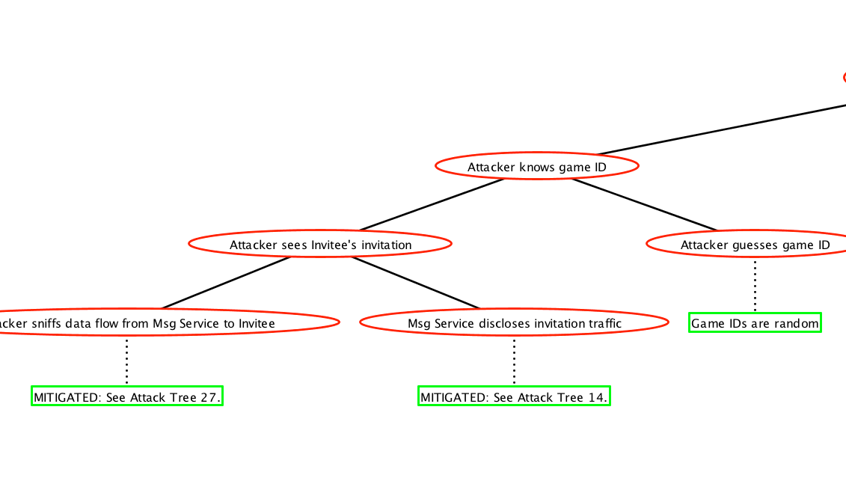
Notes:
Our Msg Service information disclosure threats are their own threats, so they have their own attack trees. But we’ll say their attack trees are entirely mitigated.
And we’ll say that, upon seeing this threat model, our lead server engineer says “oh, hey, I can make game IDs random, no problem”, so that’s mitigated too.

Slide 39
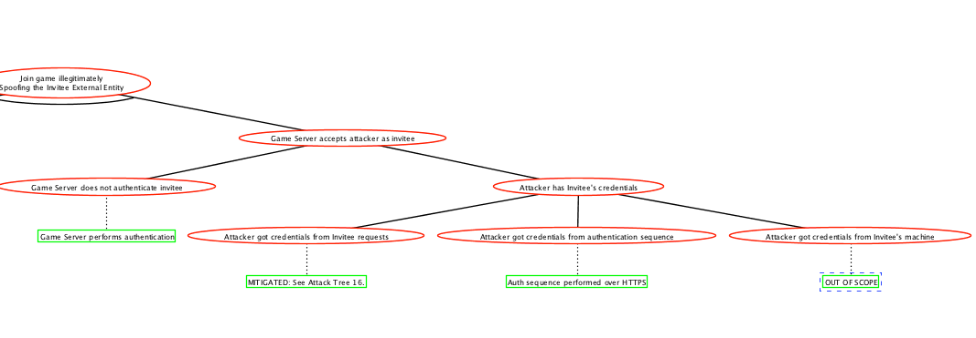
Notes:
The condition that the game server doesn’t do auth is not true; our engineer assures us that it does.
The attacker sniffing the invite request is in another attack tree, which we’ll say was already confirmed mitigated.

Slide 40
Notes:
These last two conditions—our server engineer tells us that the auth sequence happens over HTTPS, so is invulnerable to sniffing or other man-in-the-middle attacks. That may or may not be true, but it’s definitely true that any attacker with the resources to crack SSL is going to be going after Chase Manhattan, not us, so we’ll call that mitigated.
Finally, there’s the possibility that the attacker compromised the invitee’s machine and got the credentials that way. We’re going to call that OUT OF SCOPE—if that happened, it’s not our responsibility (unless our client is what made it possible), and again, we’re not the worst thing the attacker can do, so we’re not going to worry about it.

Slide 41
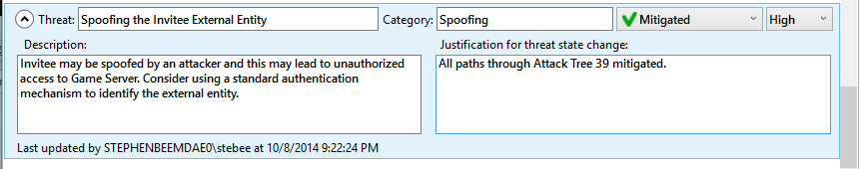
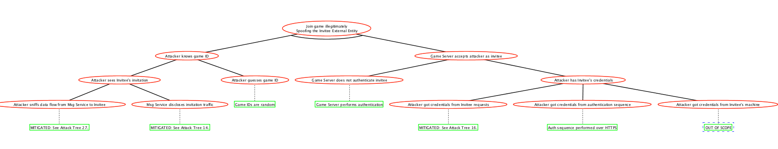
Notes:
Zooming back out, we see that the mitigations act like gates—they block off paths through the tree. There are no unblocked paths, so this threat is entirely mitigated. So we go back to our DFD document [CLICK] and mark it as mitigated.

Slide 42
Take the DFD and list out all the possible intersections—STRIDE x Elements. Each of these is a “threat”.
Some threats are impossible or out of scope. For the rest, prioritize based on potential damage, then construct attack trees to find out whether they’re mitigated or not.
Unmitigated threats are vulnerabilities.
Notes:
By their nature, certain STRIDE attack types apply to certain DFD element types. For thoroughness, we list out all the possible intersections—STRIDE x Elements. Each of these is a “threat”.
Some threats we declare impossible or out of scope. For the rest, we prioritize them based on potential damage, then construct attack trees to find out whether they’re mitigated or not.

Slide 43
LIVE DEMO
Notes:
Let’s take the Game Center DFD and make an attack tree for the key threat, user uploads bogus high score.

Slide 44
MITIGATING VULNERABILITIES
Risk vs. Effort

Slide 45
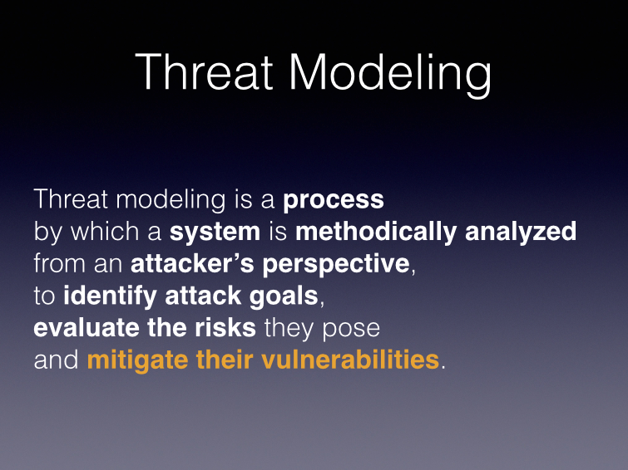
Notes:
We’re on the last part of the process!
Our formal definition of “vulnerability” is “a threat whose attack tree has one or more unmitigated paths to the root”. Any serious threat model of a genuine product is pretty much guaranteed to reveal one or more vulnerabilities. Everything up until now has been potential; vulnerabilities are real. They are bad things that can actually happen to your app. So now we go mitigate all of them, right?

Slide 46
MITIGATE EVERY VULNERABILITY
Notes:
[CLICK]
WRONG.
Not every vulnerability has to be mitigated. Yes, I’m a security professional, and I’m standing here telling you that you don’t have to mitigate every security bug. “Well duh, you used to work at Microsoft, of course you say that.”

Slide 47
Perfect
security
is
impossible
Notes:
Every system has vulnerabilities. Every system can be attacked. Every. One. Of. Them.
Don’t believe me? Okay, let me describe a perfectly secure system.

Slide 48
Notes:
[CLICK] These are uranium hexafluoride centrifuges. For scale, those are each about 2 meters tall. They spin at 90,000 RPM, the gas inside them is 600 degrees, and it’s not just radioactive but also one of the most corrosive and toxic substances known to science.
They’re controlled by [CLICK] these. This is a programmable logic controller—basically a special-purpose, high-performance real-time computer. Pwn that, and you can do whatever you want to the centrifuges, because this controls everything they do.
But the people running this place are very smart. The PLCs aren’t programmed over a network at all. To program them, you have to unplug a logic card from inside them and carry it over here… [CLICK]

Slide 49
Notes:
This is a workbench computer. It runs on Windows and is the only thing that can modify the programming on the PLCs. But again, these guys aren’t stupid, the workbench computers are in locked rooms with heavily-armed guys outside the door, and these machines never, ever browse the web. But the guys who use them still need network access, because they have a job like any other, and they have vacation forms and TPS reports to fill out. So they’re connected by a network to... [click]
...Other computers at the facility, where people do normal, boring stuff like email and web browsing. But again, these guys aren’t idiots, so even the secretary’s computer is behind a sturdy firewall and proxy servers. On the other hand, these computers don’t have nearly as many armed guards, making it possible to plug one of these into them... [click]

Slide 50
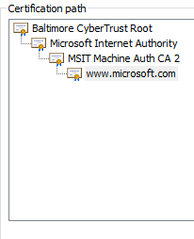
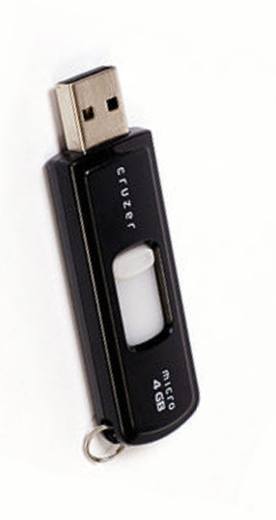
Notes:
...a USB key. But hey, again: not idiots. These guys have the best antivirus money can buy installed. But the operating system is designed to accept device drivers and other kernel modifications without complaint, as long as they’re encrypted using a valid... [click]
...certificate. Certificates are the “crown jewels” of corporations, and are protected with their highest measure of care.
Now if that’s not absolutely secure, nothing is.

Slide 51
Notes:
Well, let’s suppose you have the resources of, ahem, a major industrialized country, and you really, really want to do something unpleasant to those gas centrifuges. What do you do?
Well, first, you steal valid device driver certificates from a legitimate manufacturer. [click]
You use those, along with a few million dollars’ worth of zero-day Windows exploits, to craft a virus that is guaranteed to get past any existing antivirus program, and you put it on a USB stick. [click]
You have an agent carry it on a USB stick into the lightly-secured outer areas of the facility... [click]
...so that the next time the secretary sends out the all-hands email announcing that there’s free baklava in the kitchen, your virus will infect... [click]
...the workbench computers. At that point, your virus installs its real payload, an entirely different virus, that does nothing but watch for someone to connect a very particular brand and model of PLC to the workbench computer. When that happens... [click]
...the second virus installs a third virus into that PLC, just on the offchance that someone will then plug that PLC back into a gas centrifuge. And your PLC virus is itself fiendishly clever. It doesn’t just blow up, because the guys running the facility can just pull the power and save the equipment. No, it very slightly changes the centrifuge speed up and down, introducing harmonics and instabilities that cause the equipment to underperform and wear out much much faster, all the while reporting the correct, expected values back to the monitoring program so that the guys running the centrifuges don’t get wise and shut them down. So, a few months later... [click]

Slide 52
Perfect
security
is
impossible
Notes:
So, mission accomplished.
Do I think the people victimized by Stuxnet were careless? Not really, though they pretty clearly should have invested more effort in an air-gap between their workbench PCs and the rest of their system. But I assure you those guys cared about security a very great deal, and were by no means incompetent. If they constructed a threat model, every path through the tree would have been marked mitigated, because the amount of effort required to pull off this attack—this is Stuxnet, by the way, if you hadn’t already gotten that—the effort required was staggering. But the moral of our little story is that ALL security is a tradeoff of risk versus reward, cost versus benefit.

Slide 53
Risk = Likelihood x COST
Notes:
Security measures should be commensurate with the cost of a security breach. That is, after all, how the attacker thinks: The attacker looks at investment versus return. Somebody clearly thought Stuxnet was worth a colossal investment--it is, without question, the most expensive and sophisticated virus ever created.
What we want is to assign each vulnerability a rating that tells us what it costs not to mitigate it. Then we can compare that to how much it would cost to mitigate it, and decide whether to spend the effort. Now, a lot of the costs of vulnerabilities are not monetary but are costs to reputation, or they’re costs borne by our players that only indirectly affect us, etc. And in any case, there’s no way we could calculate accurate dollar costs of every vulnerability, and pretending like we could just sets false expectations. So we don’t calculate a dollar cost of each vulnerability, but rather calculate an abstract numerical rating.

Slide 54
REAL
Reward: What’s it worth to the attacker?
Effort: How little does the attacker have to work?
Audience: How many people will be affected?
Level of Skill: How many attackers have the skill required to carry out the attack.
Assign each a value from 1 to 10, multiply them all together and move the decimal two to the left, for a value from 0.01 to 100.0
Notes:
Microsoft has a rating scheme called DREAD, but I don’t like it much. This is what I came up with for my use.
[CLICKING]
Reward: This is really what it’s all about, what the attacker gets from it. Again, threat modeling is all about viewing your application the way an attacker does. Don’t overlook costs to you, however, because one very real attacker motivation is revenge. It’s perfectly in character for an attacker to go after you simply to cost you money, or to hurt your reputation, or to punish all those n00bs who are stupid enough to buy your games. If you don’t believe me, just ask Sony.
[click] Effort: Not an awesome word choice here, because this scale is inverted--a 1 means it’s a very difficult attack, like brute-forcing an encryption key, while a 10 means it’s completely automated.
[click] Audience: The more people who would be affected by or see the attack, the bigger the risk. Always remember that showing off is a huge motivation for attackers.
[click] Level of skill: Again, not a great word, because this is also inverted--a 1 means the attack takes a lot of skill or special resources, such that only a handful of attackers can accomplish it, while a 10 means it’s as easy as typing. Think of it as how many people have the required level of skill/resources. [click]

Slide 55
The Game Center Leaderboard Hack
Reward: 1
Effort: 10
Audience: 3
Level of Skill: 9
Total rating: 2.7
Notes:
So let’s apply these numbers to the attack we’ve been modeling here, the Game Center hack. There’s virtually no reward, because your score looks clearly fake. But there’s virtually no effort. The audience is small, because nobody even pays attention to those leaderboards. And the level of skill is almost completely trivial. These values are all arbitrary, but as long as we’re consistent with other threats we face, this will be good enough to prioritize our efforts. Net result? 2.7 out of 100. And now you know why Apple does nothing to fix this.

Slide 56
Take Action
Define a “security bar”, the risk rating above which you will act on a vulnerability.
Vulnerabilities above this bar go in your bug database.
Vulnerabilities below this bar go in your backlog.
Notes:
Pick a number within your range of risk values--so, 1-100 in this example. Set the bar somewhere within that range, based on the overall level of polish you feel your project needs. If you’re shipping on a weekly basis, maybe you start with the bar at 60 and bring it down over time; if you’re doing a console product with limited ability to patch it, maybe you set the bar at 20.
Whatever you do, don’t just forget about the other vulnerabilities. You’d rather mitigate them than not, so if they can be addressed opportunistically in the course of making other changes, you want to tackle them. Track them in your backlog, or whatever your equivalent is for your software development process.
Once you’ve determined which vulnerabilities you’re going to act on right away... take action!

Slide 57
Creating mitigations
Change the circumstances so that paths through the attack tree are closed off.
Change the risk variables so that the vulnerability falls below your security bar.
Notes:
There are two ways to address a vulnerability: One is you can simply close it off it outright. That’s certainly preferable. But that’s just bug fixing—we don’t need to go much further into that tonight. Later this semester we’ll talk about the kinds of bugs you’ll see and techniques to address them.
[CLICK] The other is that you change the variables in the risk equation so that you no longer care as much about the vulnerability. I don’t mean you simply cook the numbers so that you can ignore the problem--I’m still talking about taking action. That’s a more interesting conversation to have.

Slide 58
Change the Risk
Reduce the reward!
Increase the effort!
Limit the audience!
Raise the skill level!
Notes:
The other choice is to change the risk variables. This is not a cop-out! If you really meant it and gave some care to the risk ratings and your security bar, then a vulnerability that falls below the bar is, yes, one you can live with. It’s very common for the cost of mitigating a vulnerability to be much higher than the cost of reducing its impact. Moral #3 of the Stuxnet story is that, since perfect security is impossible anyway, imperfect solutions, such as merely making an attack more difficult, are just as valid as “perfect” solutions.
If the attack is less rewarding, then you care less about it happening. This one is a super-common approach
If the attack is more difficult, then it’s less likely the attacker will bother.
If the attack affects fewer users, then it’s less appealing to the attacker, and less costly for you if it happens.
If the attack requires more advanced skills, you limit its likelihood, since sophisticated attackers presumably have more enticing targets to go after. (You don’t have to worry about the Stuxnet creators going after your 99 cent iPhone game, for example.)
At MSN Games, we had a huge hacking problem, because the multiplayer games were written years prior and were hopelessly naive--they trusted the client and sent game data back and forth unencrypted. Rewriting the game to be client-server, with the server moderating the rules and protecting secret data, was far out of reach. But encrypting the overall data stream was an easy code change. Now, all the previous attacks were still possible, once you decrypted the stream. And the encryption key for the stream was embedded in the client (unavoidably). But whereas before you just needed a packet sniffer to hack MSN Games, now you needed the ability to decompile code. The problem basically vanished.
This is why human factors of your attackers are so important. The human factors of your attackers are really important. On Ultima Online, we had a pretty major hacking problem, but what we discovered is that the people using the hacks weren’t the ones creating them. Understanding UO’s packet protocol well enough to exploit it took skills and effort. The hackers with those resources weren’t playing the game. What they were doing is writing “gray-world servers”, servers that ran their own versions of the world but were still compatible with the stock client. They’d sell subscriptions to these gray-worlds, and (partially to show off, and partially as advertising for their gray-worlds, and partially to reduce the appeal of the legitimate game) they’d also develop and release hacking scripts for UO. Reducing the reward of gray-worlds (by getting their servers shut down) reduced the hacking.

Slide 59
Security through Game Design
Notes:
Anybody played Superhero Squad Online? Cute game. It’s an MMO, and like all MMOs, it rewards you for playing. It’s a freemium game, and like all freemium games, there’s stuff you really want, which in our case was purchased with gold, and then there’s stuff that’s kinda nice to have, which in our case was purchased with silver. It’s important in freemium games that you be able to get a little gold just by playing.
In UO, or WoW, or other big-scale MMOs, the server is authoritative--the game simulation is running on the server, and your client is just showing you the effects. That’s the big, expensive way to do it. SHSO was made with a much smaller team and tries to run much cheaper. In it, the game simulation happens on the client.
But, as we all know, the game client is evil and can’t be trusted. If I can get gold in return for playing, and my game client can simulate my playing, then I can just set up an engine to pretend to play 24 hours a day for me, make mad bank and buy everything the game has to offer in a week. So the game designers created the Prize Wheel. Playing the game doesn’t give you direct rewards, it gives you spins of the Prize Wheel. Every time you win gold off the wheel, that spot is replaced with silver. And the Prize Wheel is running on the server, not the client. So even if you automated the entire system and got 10,000 prize wheel spins a day, there’s a (low) limit to the amount of gold you could possibly get... and there’s separate systems to detect people who spin the wheel 10,000 times a day.
This setup saved literally hundreds of thousands of dollars in developer time, server resources and/or stolen freemium inventory, and it was a security mitigation created by the game designers.
And this wasn’t just lowering the risk rating--with the amount an attacker could steal from us being capped at a low number, that counts as a straight-up mitigation in the threat model.

Slide 60
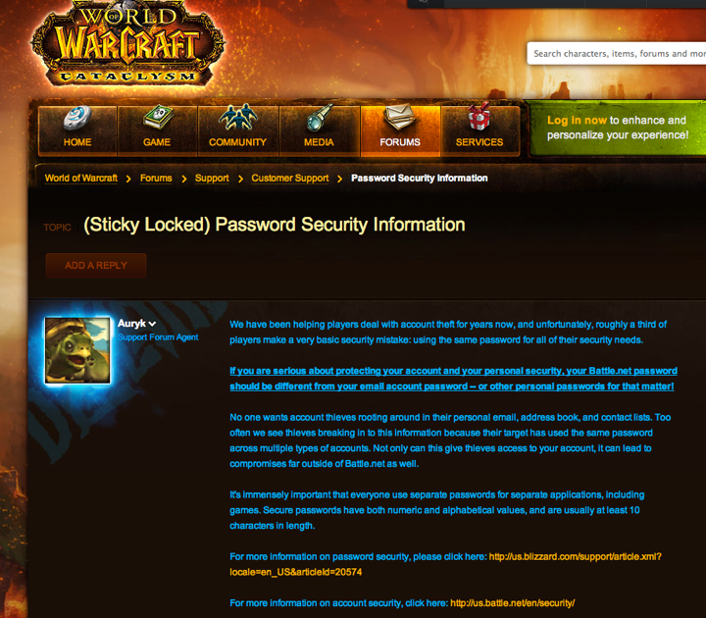
Security through Community management
Notes:
Game designers aren’t the only place to look for security mitigations. Community managers can mitigate security problems through educating users. Here, Blizzard is limiting the vulnerable audience.

Slide 61
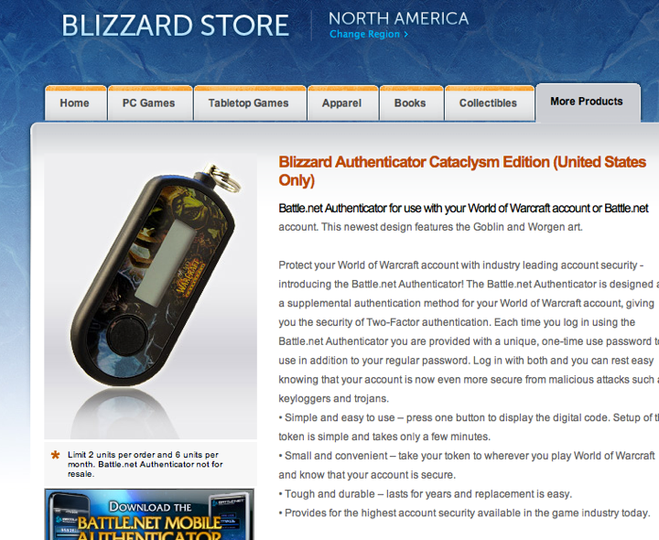
Security Through
Business Development
Notes:
Admittedly, it took a little programmer time to hook up the Blizzard Authenticator--but not much. Most of the time spent on this initiative came from the business team to actually make it happen and the e-commerce team to handle sales and fulfillment of the devices, and of course the operations team to get the system deployed.
This is why I stressed that this isn’t a programming talk. I’ll come back to this point later, but: If you use the threat modeling process as a way to educate more people on your team about how security works in your application, then those people can look for ways to help you make your app more secure.

Slide 62
Lather
Rinse
Repeat
Notes:
Almost certainly, once you’re “done” with the application you’re not really done. Even console developers don’t have that luxury. Don’t just create a threat model, address some vulnerabilities and then say “we win!” You should plan to re-run your threat model periodically.
Repeating the threat model process goes faster than the first pass, since you’re mostly looking for what’s changed.

Slide 63
Perfect security is impossible, but zero security is unacceptable. You have to strike a smart balance.
Risk is likelihood times cost.
Making attacks impossible is best.
Making attacks less likely or less costly might be just as good.

